Slide 1
Traffic Light Implementation
Using BeagleBone Black

Slide 2
Specification
BeagleBone Black is a low-cost, community-supported development platform for developers and hobbyists.
Processor :
1.AM335x 1GHz ARM® Cortex-A8
2. 512MB DDR3 RAM
3. 3D graphics accelerator
4. 4GB eMMc card

Slide 3
Connectivity:
1. USB client for power & communications
2. USB host
3. Ethernet
4. HDMI
5. 2x 46 pin headers
Software Compatibility:
1.Default OS: Angstorm
2.Debian
3.Cloud9 IDE
Boot Linux in under 10 seconds and get started on development in less than 5 minutes with just a single USB cable.

Slide 4
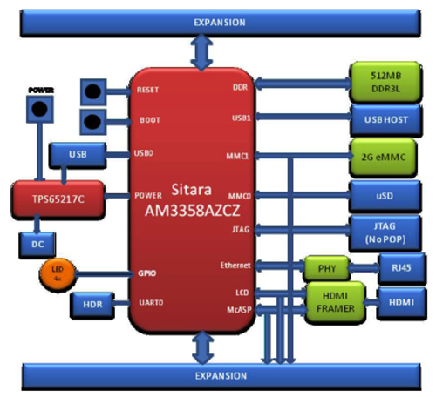
Block Diagram

Slide 5
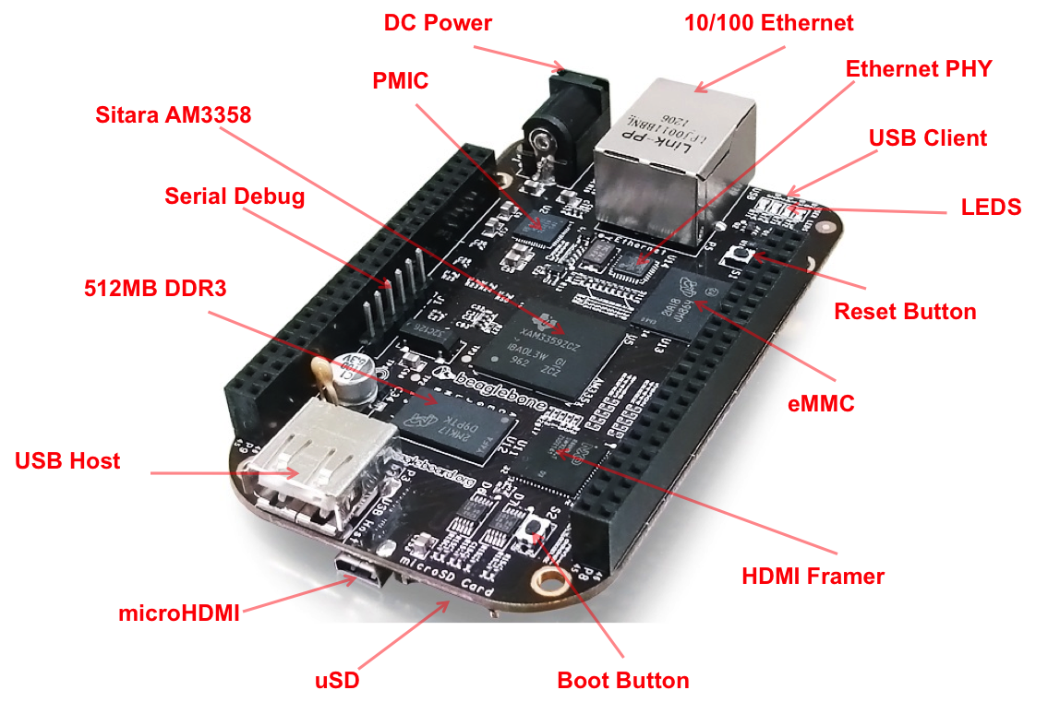
Overall structure

Slide 6
Adafruit’s BeagleBone IO Python Library
This is a set of Python tools to allow GPIO and ADC access on the BeagleBone using the Linux 3.8 Kernel and above (latest releases).
It has been tested on the 5-20 and 6-6 Angstrom image on the BeagleBone Black.

Slide 7
Demonstration

Slide 8
Thank You !

